Slide 1
Interpretability for Computational Biology — An-phi Nguyen PreDoc Researcher
IBM Research
Notes:
Introductory information, maybe a couple of jokes
Let's start...

Slide 2
Why Interpretability?
Notes:
Interpretability is one of those concepts that everybody kinda knows what it is, but at the same time is difficult to pinpoint. So before talking about what interpretability is, let's first see why we would want it.
I do research in interpretability with applications in systems biology and healthcare so I have 3 main reasons why I'd like to achieve interpretability, whatever that is.

Slide 3

Why Interpretability?
Well, everybody is using this software
Are you sure about this diagnosis?
Trust
e.g. doctors and patients may want to know why a diagnosis was suggested by an automated system
Notes:
In many high-risk scenarios, such as healthcare, a decision provided by an automated models con have far-reaching and potentially negative consequences. Interpretability is needed to provide to the user a certain confidence that the prediction was correct.

Slide 4
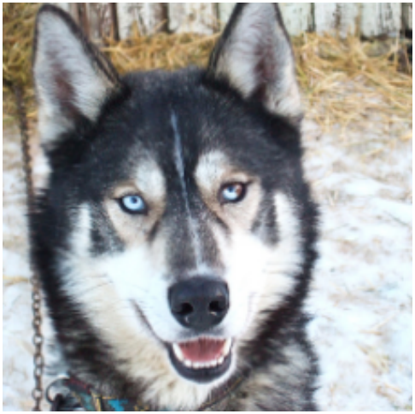
Why Interpretability?
But... it says that I am pregnant.
Trust
Debugging
a model is providing weird results, but why? Problem can be in either the model or the dataset
Notes:
If the user is not confident about the results, there might be something wrong. The cause might be that the model was badly trained or was not the most appropriate one for the task at hand,... or was trained on data that was biased in an unwanted way. Interpretability can be used to detect problems both problems in the model or the data.
For example, a computer vision was model was trained to distinguish husky vs wolf. This sample was misclassified as wolf. An interpretability method that we will see later was used and it revealed that the trained model was classifying an image as wolf whenever there was snow in the background.

Slide 5

Why Interpretability?
It's lupus!
Trust
Debugging
Hypothesis generation
conversely, a model might have been able to discover patterns unknown by experts
Kristin Dos Santos - CC BY-SA 2.0
Notes:
Finally, sometimes surprising results may not be consequences of some negative unwanted cause, but just a result of a pattern or mechanism that was unknown even to experts. Interpretability can be used to unveil these patterns and potentially lead to new biological hypothesis that can be later on independently validated in later studies.

Slide 6



What is interpretability?
DISCLAIMER (1): in this tutorial we will use explanability and interpretability interchangeably
"tell the meaning of : present in understandable terms", "to make known, plain or understandable" (Merriam-Webster, 2019)
...but no agreed upon formal definition
Difficult to evaluate and compare different methods
“you’ll know it when you see it” [1]
[1] Doshi-Velez, Finale, and Been Kim. "Towards a rigorous science of interpretable machine learning." arXiv preprint arXiv:1702.08608 (2017).
Notes:
Now that we know why we want interpretability, how should we define it. First a disclaimer, in this talk I will use
The Merriam-Webster dictionary defines interpretability as … This intuitively makes sense, but is not a formal definition so it is difficult to rigourosly discuss about it in a scientifically air-tight manner. This leads to a difficulty in systematically evaluating and comparing existing methods. Nowadays, when a method is proposed, one of the ways to show whether the explanations produced are valuable is to qualitatively show some examples.. "So you know that a method is interpretable when you see it"

Slide 7
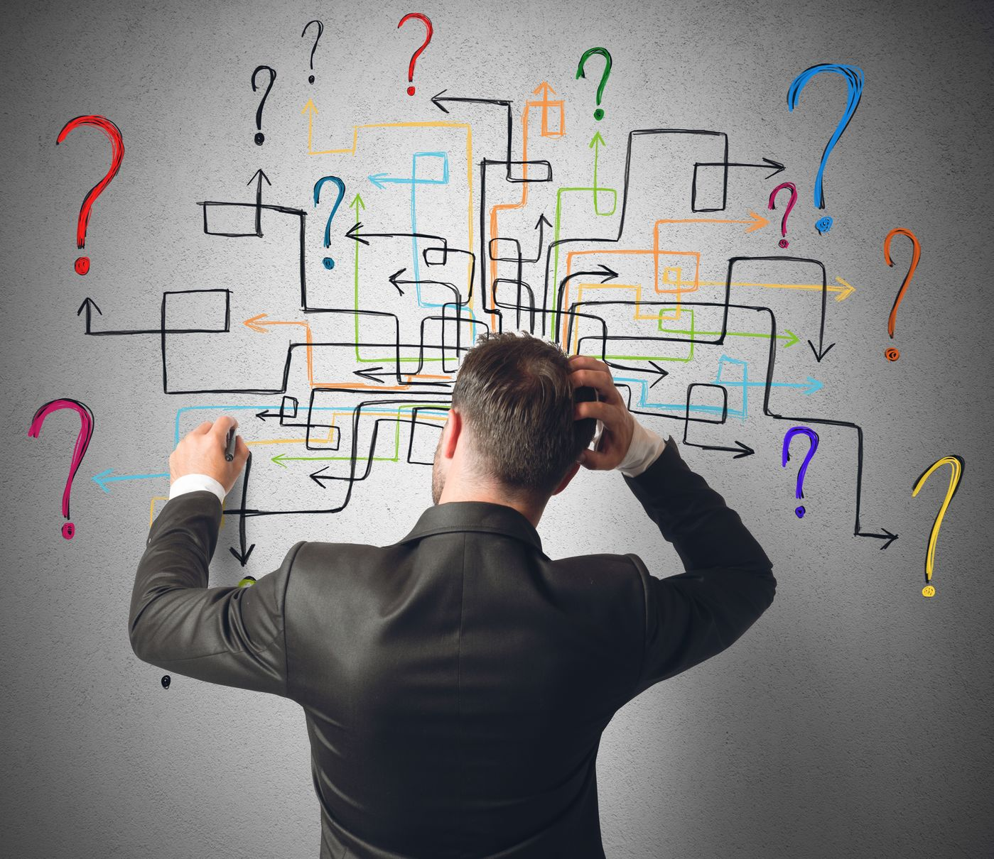
Why this tutorial then?
Being able to interpret a model is important if not necessary sometimes.
Many researchers have already proposed (post-hoc) interpretable methods.
For the correct use of these methods, it is fundamental to understand them.
Notes:
So if there is no agreed upon definition, what's the purpose of this tutorial. Interpretability already made itself necessary in many scenarios. For example, last year the EU implemented the GDPR, a regulation/EU law on data protection and privacy. This regulation contains the "right to an explanation".
However, there are already many methods out there, so if some explanations need to be produced in some scenarios it is important to achieve a better understanding of the available methods.

Slide 8
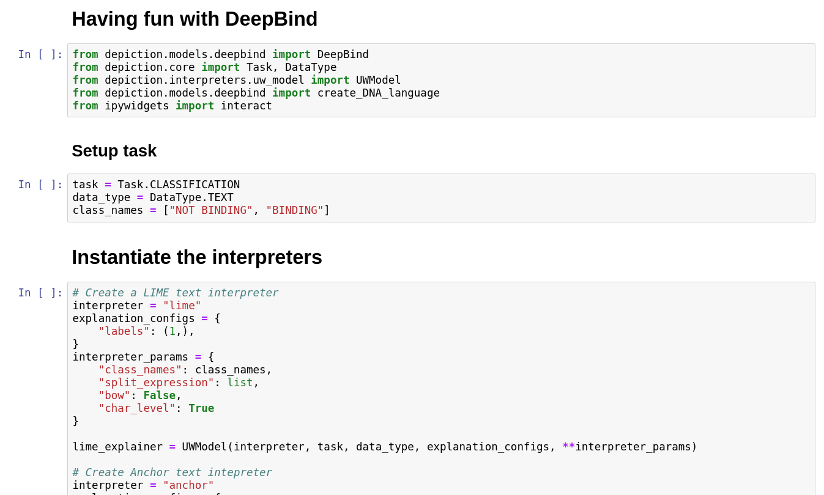
Why this tutorial then?
DISCLAIMER (2): this tutorial is to give an overview of some existing models. The methods presented are not necessarily aligned to how we think interpretability should be defined.
For further discussions, reach out to me at the end of the tutorial, or contact me via email :D (uye@zurich.ibm.com)
Notes:
I'd like to add that in this tutorial I will give an overview of the existing models, but the explanations that they provide, although appealing, are not necessarily aligned to what I think is interpretable.
For example, I personally think that a method is interpretable if it provides you at least some degree of operational understanding. This means that given an explanation one should be able to modify the sample in such a way that a desired outcome can be achieved. To use a catchy phrase I think that "Interpretability is control". In fact, in one of the tutorials we will see that sometimes it is not easy to use the explanations in this way.

Slide 9
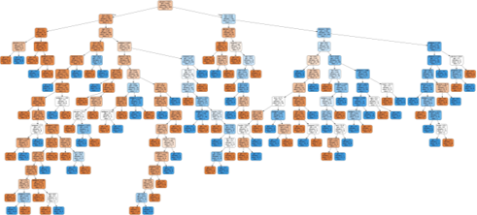
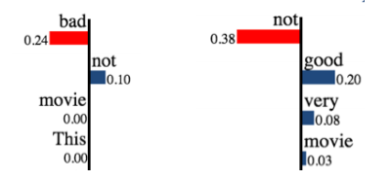
Taxonomy of interpretable methods
LOCAL
Explanation is provided for a single sample.
Examples: perturbation-based methods,…
PROS: (arguably) easy to understand, (not necessarily) fast to compute
CONS: not guaranteed to be representative, other cons depending on the method
GLOBAL
The decision process of the method is provided in "its entirety", i.e. on the whole input space.
Examples: decision trees, rule lists, …
PROS: fully transparent and representative
CONS: (potentially) computationally heavy, (ironically) difficult to understand
Further nomenclature for interpretability methods:
Ante-hoc: methods with built-in interpretability (e.g. attention models, decision trees)
Post-hoc: methods to be applied to other models. NOTE: ante-hoc methods can be used as post-hoc methods.
Notes:
But enough chit-chat and let's dive in some more technicalities.
Let's first have a general look at the landscape of interpretability. In general, we can broadly divide the methods in two classes depending on what kind of explanations they provide.
The first one provides LOCAL explanations, that is it provides rules or an intuition of why a specific sample was classified in a certain way. We will see some examples later. Advantages of some of this methods are easiness and computational (not always), however they are often misleading in the sense that by looking at a single explanation we might be lead to believe that it has an universal value (this concept is similar to the concept of generalization in machine learning).
Global methods on the other hand provides a view on the entire decisional process that is valid for all the samples. Examples are … . These methods are however often difficult to train and (ironically) to understand.
Interpretablity methods are often also defined as ante-hoc or post-hoc. Ante-hoc models are those that... While post-hoc models are those that are used to explain some other models.

Slide 10
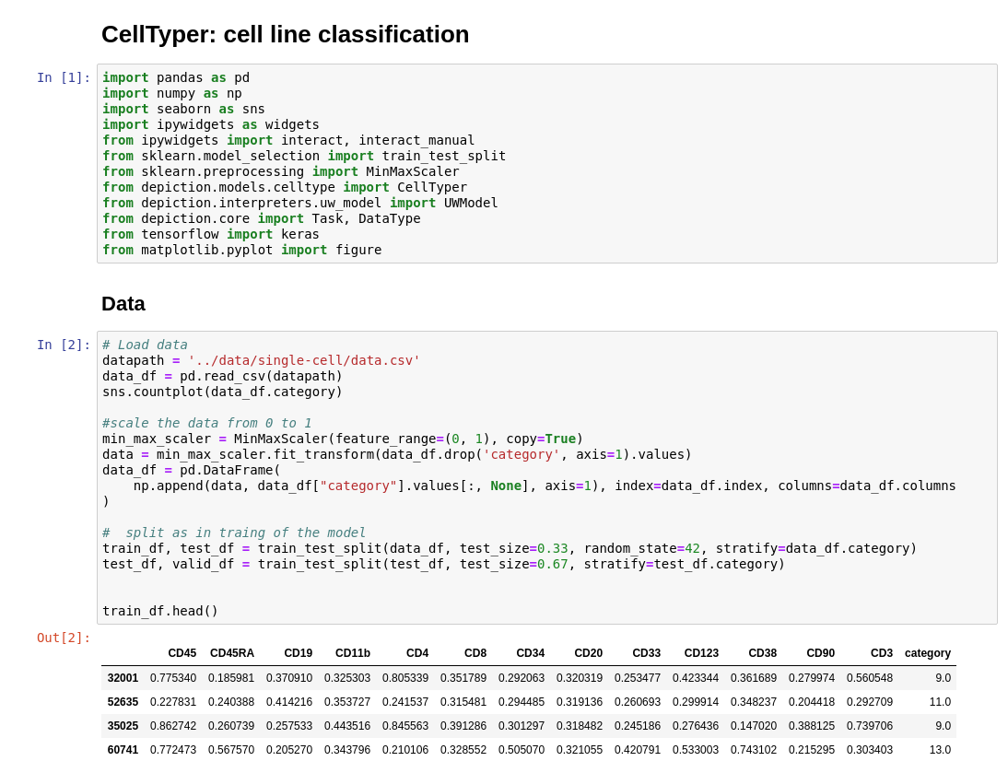
Taxonomy of interpretable methods
Why would we bother developing complex models for prediction if we can use already interpretable models?
Sometimes interpretability comes at the cost of accuracy
Simple Model
Complex Model
vs.
Notes:
One question may arise now. If there are so many models out there, and some are already interpretable … why should we keep researching. Leaving aside the matter about what interpretability is … there are 2 reasons to continue this research. Often interpretability comes at a cost in accuracy (similarly to the concept of bias-variance trade off). This is not always true and we will see this in the first tutorial this afternoon.

Slide 11
Taxonomy of interpretable methods
Why would we bother developing complex models for prediction if we can use already interpretable models?
If global, even interpretable models may be difficult to interpret
Notes:
Other times interpretable models are not actually interpretable... so we need ways to solve this.. And the solution may lay in the middle ground.

Slide 12
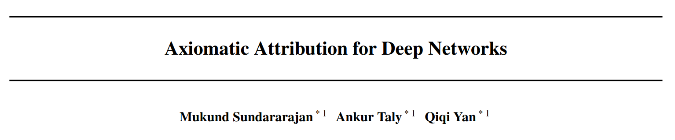
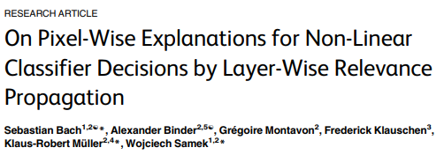
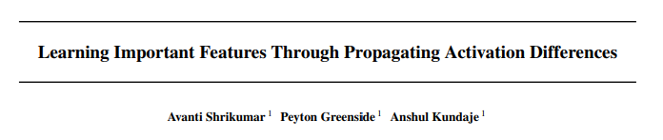
Backpropagation-like methods
Local methods
Based on backpropagating an importance score
Fast to compute...
… but applicable only on known architectures
Notes:
Let's have a look now at a first class of interpretability methods.. The ones based on the concept of backpropagation. These methods are based on the idea of propagating a certain relevance score from a computed output all the way to the input so to achieve an understanding of which features in the input are important for a prediction.

Slide 13

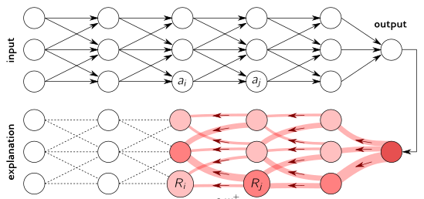
Backpropagation-like methods
Sc
http://www.heatmapping.org/
Notes:
Let's see this with an example. Here this hand written digit from the MNIST dataset is classified as a zero, and we would like to understand why is that? We therefort perform a forward pass in our architecture and obtain a certain prediction (in this case it is probably a logit). We then propagate this value back layer by layer through the network and compute the importance of each neuron towards that particular prediction. In this figure this is denoted with R_ ...

Slide 14
Backpropagation-like methods
Notes:
There are many ways to compute this relevance scores. Here are some reference.

Slide 15
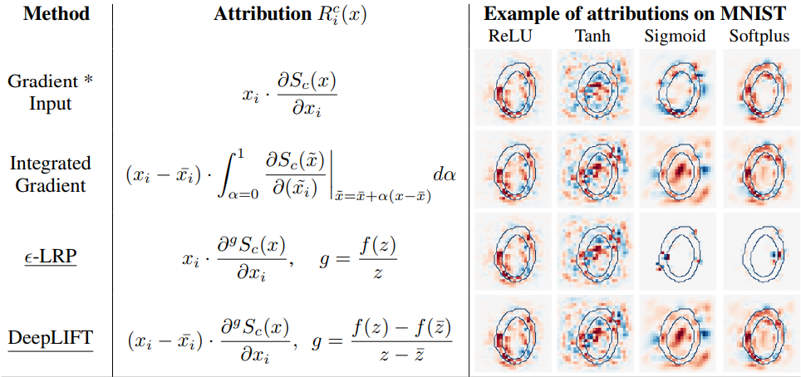
Backpropagation-like methods
Ancona, Marco, et al. "Towards better understanding of gradient-based attribution methods for deep neural networks." arXiv preprint arXiv:1711.06104 (2017).
Notes:
Here are some functional forms for revelance scores from those papers. I won't go into the details of these formulations.
Let's have a look at what kind of results these methods produce. Let's take a CV model that uses sigmoids as activation function. In these images the color indicates the importance of the pixels toward classifying the digit as 0. Red counts positively and blue. Here we can see that different methods provide different explanations, most of them seem to make sense to a certain degree, so which one would you choose? At the end of the talk we will see some criteria that can be used to evaluate these methods and that could help with the decision.

Slide 16
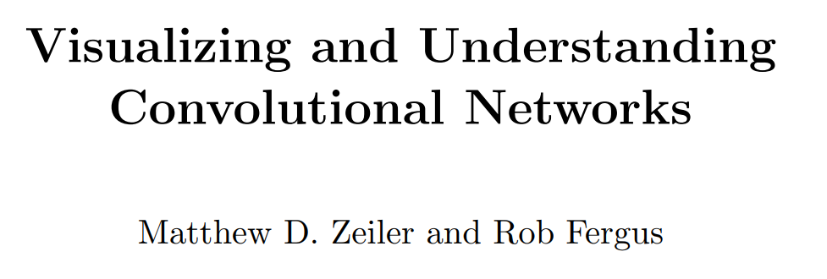
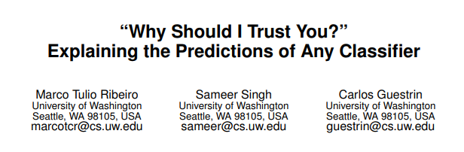
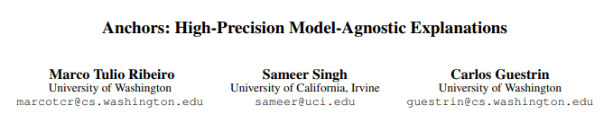
Perturbation-based methods
Local methods
Do not need to know the model architecture
Idea: analyze how small changes in the input change the output
But computationally heavy, and need to know how to perturb a sample
Notes:
As mentioned, the main problem with backpropagation-like methods is that they require knowledge about the architecture of the machine learning model to-be-explained. Pertubation-based methods try to solve this problem.
These are local methods, and they bypass the requirements of knowledge of the architecture by working only in the input space. That is... these methods perform some kind of sensitivity analysis, I.e. they apply some small changes to the input and then they analyze the output to understand how important certain features are towards the classification. This though can get very computationall heavy and requires some kind of domain knowledge to understand what perturbations make sense.

Slide 17
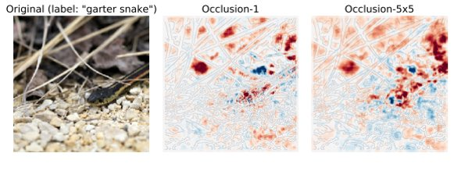
Perturbation-based methods
OCCLUSIONS
Perturb sample by occluding some pixels
But what does occlusion mean?
Zeiler M.D., Fergus R. (2014) Visualizing and Understanding Convolutional Networks. In: Fleet D., Pajdla T., Schiele B., Tuytelaars T. (eds) Computer Vision – ECCV 2014. ECCV 2014. Lecture Notes in Computer Science, vol 8689. Springer, Cham
Notes:
For example, in computer vision a method that is sometimes used is to occlude certain part of the images. This intuitevely makes sense to us, but is it actually the proper way to interpret the model? In fact there are many ways to occlude an image depending on the size/color/coherency of the occlusions.

Slide 18
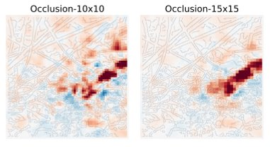
Perturbation-based methods
Zeiler M.D., Fergus R. (2014) Visualizing and Understanding Convolutional Networks. In: Fleet D., Pajdla T., Schiele B., Tuytelaars T. (eds) Computer Vision – ECCV 2014. ECCV 2014. Lecture Notes in Computer Science, vol 8689. Springer, Cham
Notes:
If we focus only on the size, we can see that the explanations provided vary a lot depending.
This example together with the previous digit classification one, already highlight a possible pitfall in trying to evaluate models just by "knowing it when you see it". Confirmation bias, humans usually tend to choose explanations that confirm what they already believe. Moreove, there are studies highlighting the fact that humans tend to prefer simple explanations.

Slide 19
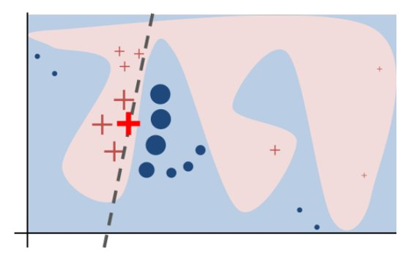
Perturbation-based methods
LIME
Perturbs samples in a neighborhood of a sample
Then fits a linear model
The weights of the linear model are used as importance score of the features
Ribeiro, Marco Tulio, Sameer Singh, and Carlos Guestrin. “‘Why Should I Trust You?’” Proceedings of the 22nd ACM SIGKDD International Conference on Knowledge Discovery and Data Mining - KDD ’16 (2016): n. pag. Crossref. Web.
Notes:
Moving on.. The importance of the occluded parts, in the most simple way, is obtained by just predicting the output on the new samples by running the modified input in the neural network. If the network is big, since often a lot of perturbed samples need to be generated to properly compute importances, occlusions can be very computationally demanding.
LIME's strategy is to compute the importance of the features by fitting a linear model to the generated perturbed samples. The weights of the the linear model are then used to assess the importance of the features. On a more implementational note, LIME can be considered more "model-agnostic" since it allows to define what perturbation means. In fact, occlusions may not make much sense as perturbations, outside from the visual applications.

Slide 20
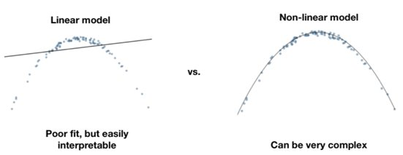
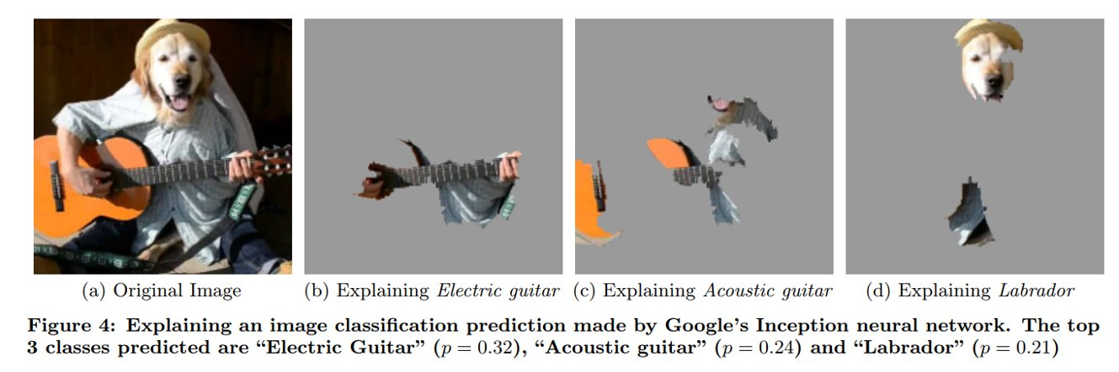
Perturbation-based methods
Ribeiro, Marco Tulio, Sameer Singh, and Carlos Guestrin. “‘Why Should I Trust You?’” Proceedings of the 22nd ACM SIGKDD International Conference on Knowledge Discovery and Data Mining - KDD ’16 (2016): n. pag. Crossref. Web.
Notes:
Here is an example of trying to explaining some predictions. Shown on the right are the most important pixels to classify ….
However, LIME uses a linear model, and as we saw before this can be very limiting and, hence, may not provide the "correct" explanations.

Slide 21
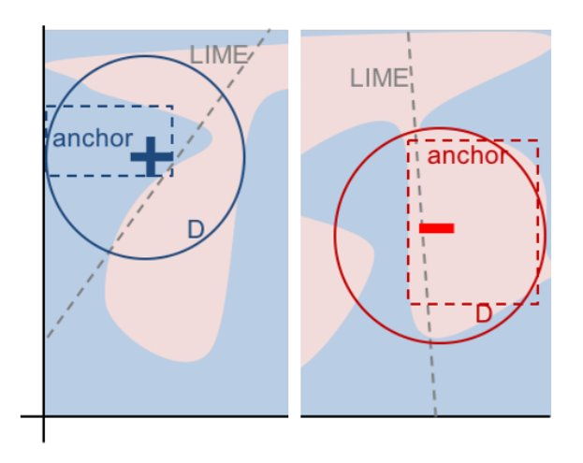
Perturbation-based methods
ANCHORS
Extension of LIME to nonlinear functions
Explanation defined as a set of minimal features sufficient to achieve a prediction
Ribeiro, Marco Tulio, Singh, Sameer, and Guestrin, Carlos. "Anchors: High-Precision Model-Agnostic Explanations" AAAI Conference on Artificial Intelligence (2018): n. pag. Web. 12 Jul. 2019
Notes:
Anchors try to solve this by extending the formulation to non linear functions. However, we have seen again that complex nonlinear models are not interpretable. The authors of anchors then redefine explanations. Here explanations are not the complete set of features together with their importance score, but are the minimal subsets of features sufficient to achieve a desired prediction. In a sense a particuklar prediction is anchored to these minimal features, hence the name I guess

Slide 22
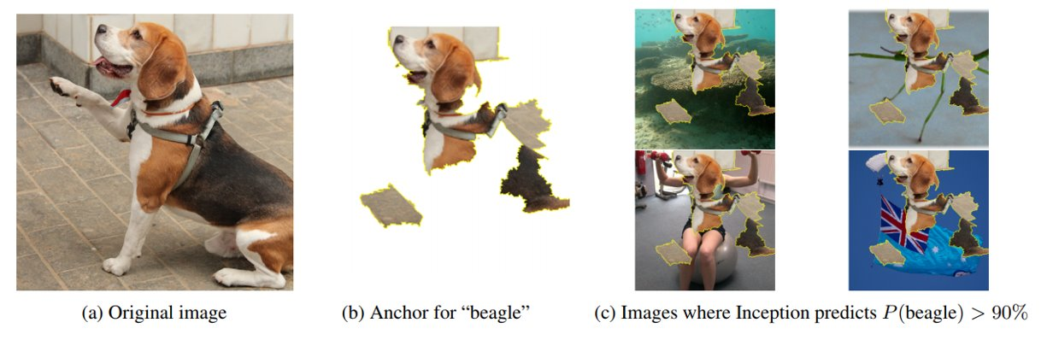
Perturbation-based methods
Ribeiro, Marco Tulio, Singh, Sameer, and Guestrin, Carlos. "Anchors: High-Precision Model-Agnostic Explanations" AAAI Conference on Artificial Intelligence (2018): n. pag. Web. 12 Jul. 2019
Notes:
In this example, we can see how Anchors worked on a image classification task. The sufficiency is experimentally shown by overlapping the sufficient "features" or pixels on other images and checking if the prediction is still beagle. While very appealing it is important to note that this is not an exhaustive proof. Anchors is still a local method and we are not guaranteed that this overlapping will work on all the possible images.

Slide 23
Perturbation-based methods
LIME VS ANCHORS
Task: classify these sentences as a positive or negative reviews.
Sentence 1: This movie is not bad.
Sentence 2: This movie is not very good.
Ribeiro, Marco Tulio, Sameer Singh, and Carlos Guestrin. “‘Why Should I Trust You?’” Proceedings of the 22nd ACM SIGKDD International Conference on Knowledge Discovery and Data Mining - KDD ’16 (2016): n. pag. Crossref. Web.
Ribeiro, Marco Tulio, Singh, Sameer, AND Guestrin, Carlos. "Anchors: High-Precision Model-Agnostic Explanations" AAAI Conference on Artificial Intelligence (2018): n. pag. Web. 12 Jul. 2019
Notes:
Here we compare lime vs anchors on a sentiment classification task. We are given movie reviews and the machine learning model is tasked with classifying them as positive or negative. The two sentences are …
LIME gives us these importance scores. Here as said before we can notice again a drawback of local methods: we are not sure if the rules that we infer are generally valid.
Anchors partially solve this problem by allowing for non linear functions.

Slide 24
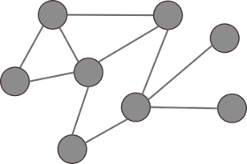
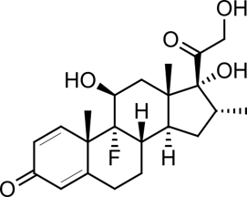
Perturbation-based methods
For complex models often:
is difficult to define a meaningful perturbation
computations may take very long
Notes:
But again, the main drawbacks of perturbation methods are the computational demand and the necessity of domain knowledge to define a perturbation. This second reason actually has quite some consequences from an implementational point of view, in the sense that is actually not easy to implement a completely model agnostic method. We will see in one of the tutorials that using these methods is actually impractical. The model discussed in the tutorial PaccMann, a quite complex model for drug discovery. In these models my colleagues achieve interpretability with an alternative, built-in methods, I.e. by using attention.

Slide 25
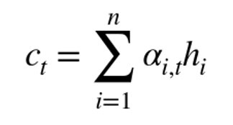
Attention-based methods
What is attention?
Introduced to solve to help RNNs with long sequences
Idea (inspired by human brain): for each prediction only few features are needed
In practice, a prediction is obtained as an adaptive weighted sum of features
Interpretability
Local method
Attention weights are interpreted like in linear models
c_{t-2}
c_{t-1}
c_{t}
...
h_{t-2}
h_{t-1}
h_{t}
...
i_{t-2}
i_{t-1}
i_{t}
c_{t-2}
c_{t-1}
c_{t}
αi,t
...
h_{t-2}
h_{t-1}
h_{t}
...
i_{t-2}
i_{t-1}
i_{t}
https://technopremium.com/blog/rnn-attention-mechanism/
Vaswani, Ashish, et al. "Attention is all you need." Advances in neural information processing systems. 2017.
Notes:
Attention is an implementational mechanisms that was introduced to overcome difficulties in training RNNs on long sequences. I will give a very brief overview on the idea, and some results that can be achieved by using this mechanism.
The main idea of attention stems from a comparison on how humans seem to think, in the sense that for us it seem to be easier to focus nly on few aspects of a matter to achieve a conclusion. In the same way, attention modules in neural networks aim to learn the importance of features in computing a prediction. Here is a very simplistic schematic comparing a basic RNN and an RNN with attention. The final decision is obtained as a weighted sum of the "features". Note that the weights in the sum change from sample to sample... I.e. attention is a local interpretability model. There are many ways to compute this alphas from the sample, and you can find some in this paper. And more among its references.

Slide 26
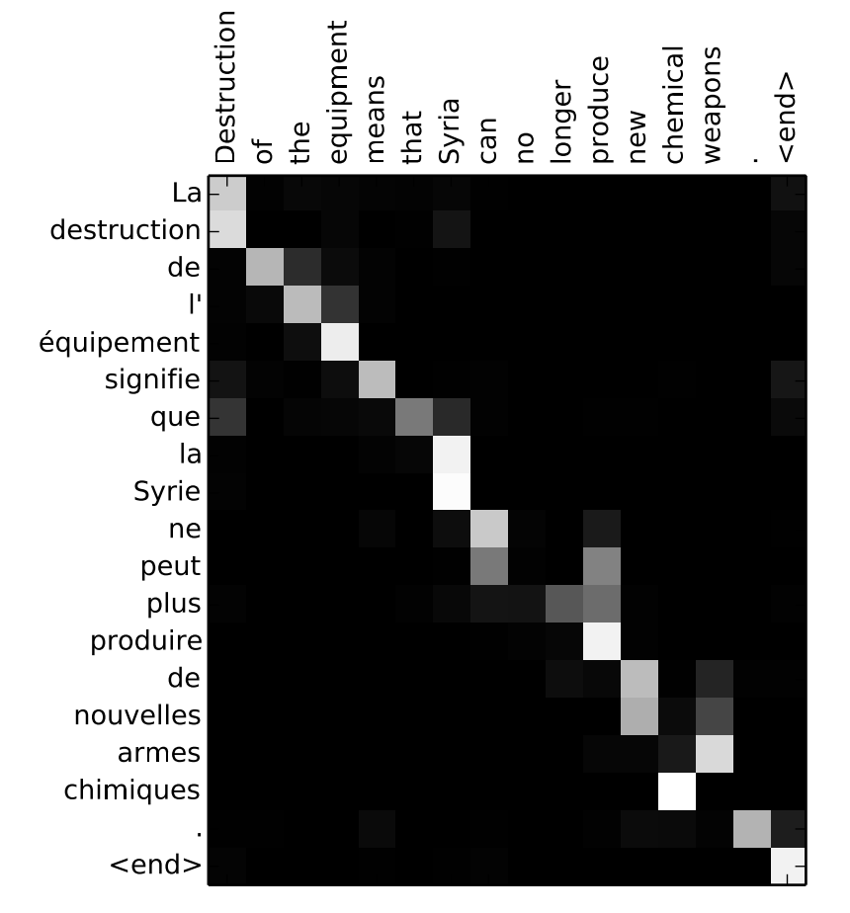
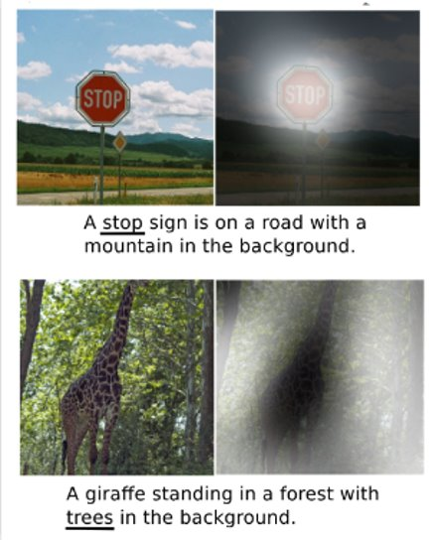
Attention-based methods
http://www.wildml.com/2016/01/attention-and-memory-in-deep-learning-and-nlp/
Bahdanau, Dzmitry, Kyunghyun Cho, and Yoshua Bengio. "Neural machine translation by jointly learning to align and translate." arXiv preprint arXiv:1409.0473 (2014).
Notes:
Let's have a look at some attention-related results
The first example concerns machine translation from french to english...
The second example is for image captioning. In these task there is a neural network that has to produce, given an image, a caption describing it...

Slide 27
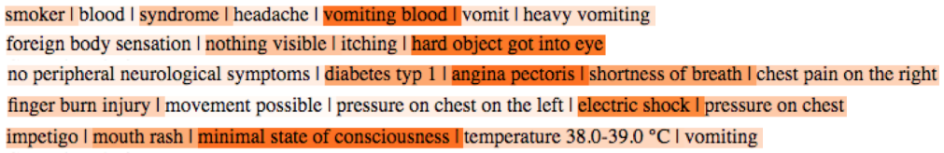
Attention-based methods
Girardi, Ivan, et al. "Patient Risk Assessment and Warning Symptom Detection Using Deep Attention-Based Neural Networks." Proceedings of the Ninth International Workshop on Health Text Mining and Information Analysis. 2018.
Notes:
We used the same mechanism in a healthcare application developed at IBM for point-of-care prediction.. The task is to predict... . The attention mechanism was used to detect the main symptoms used to achieve a prediction.

Slide 28
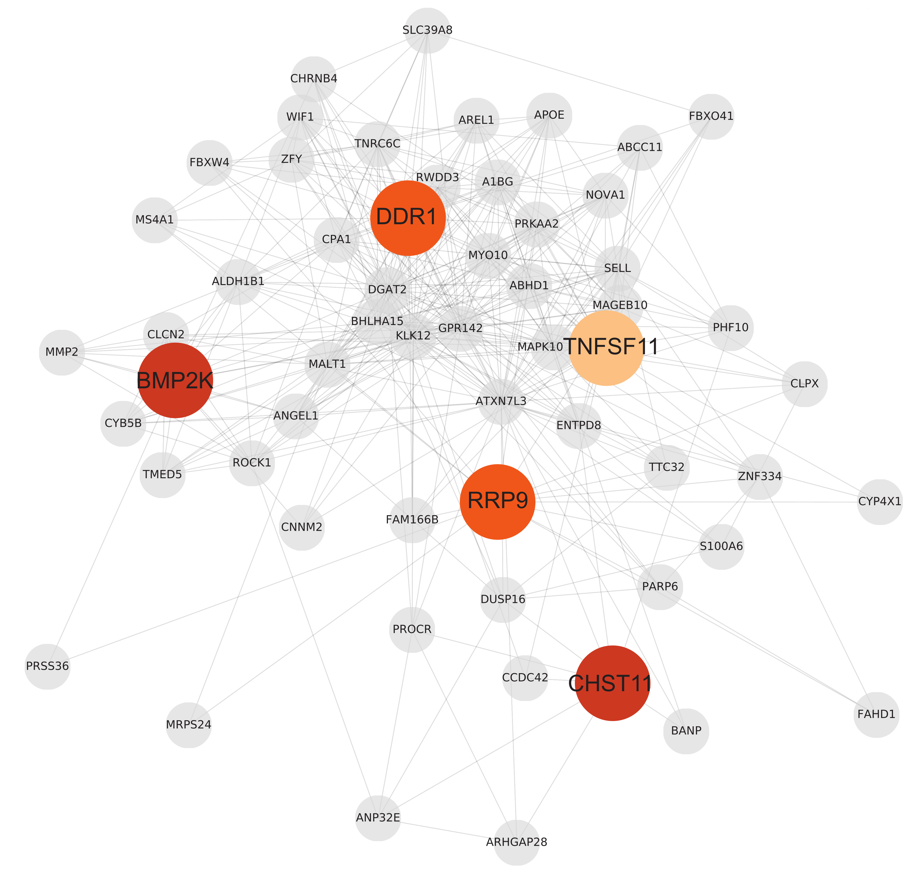
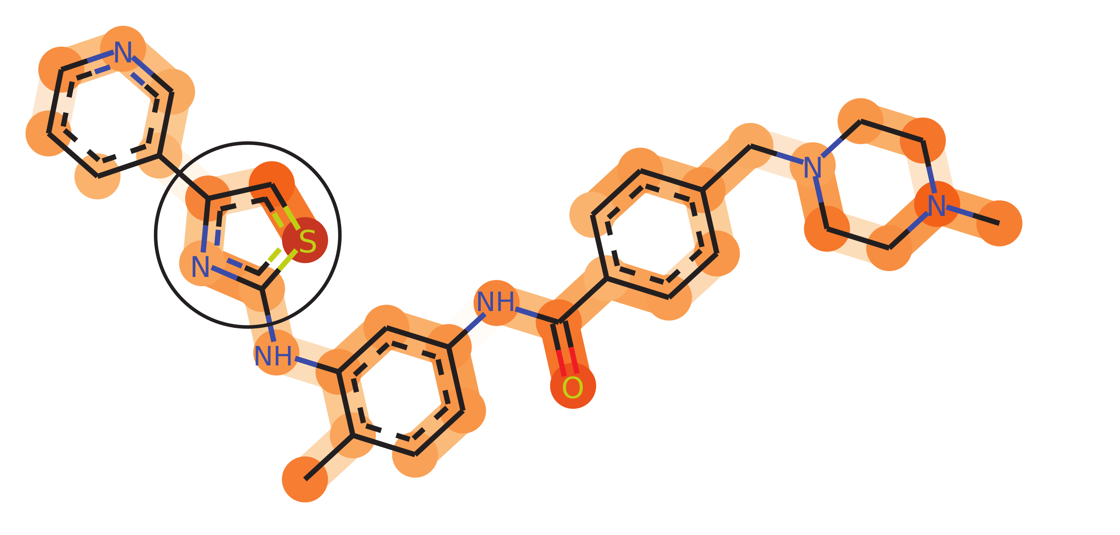
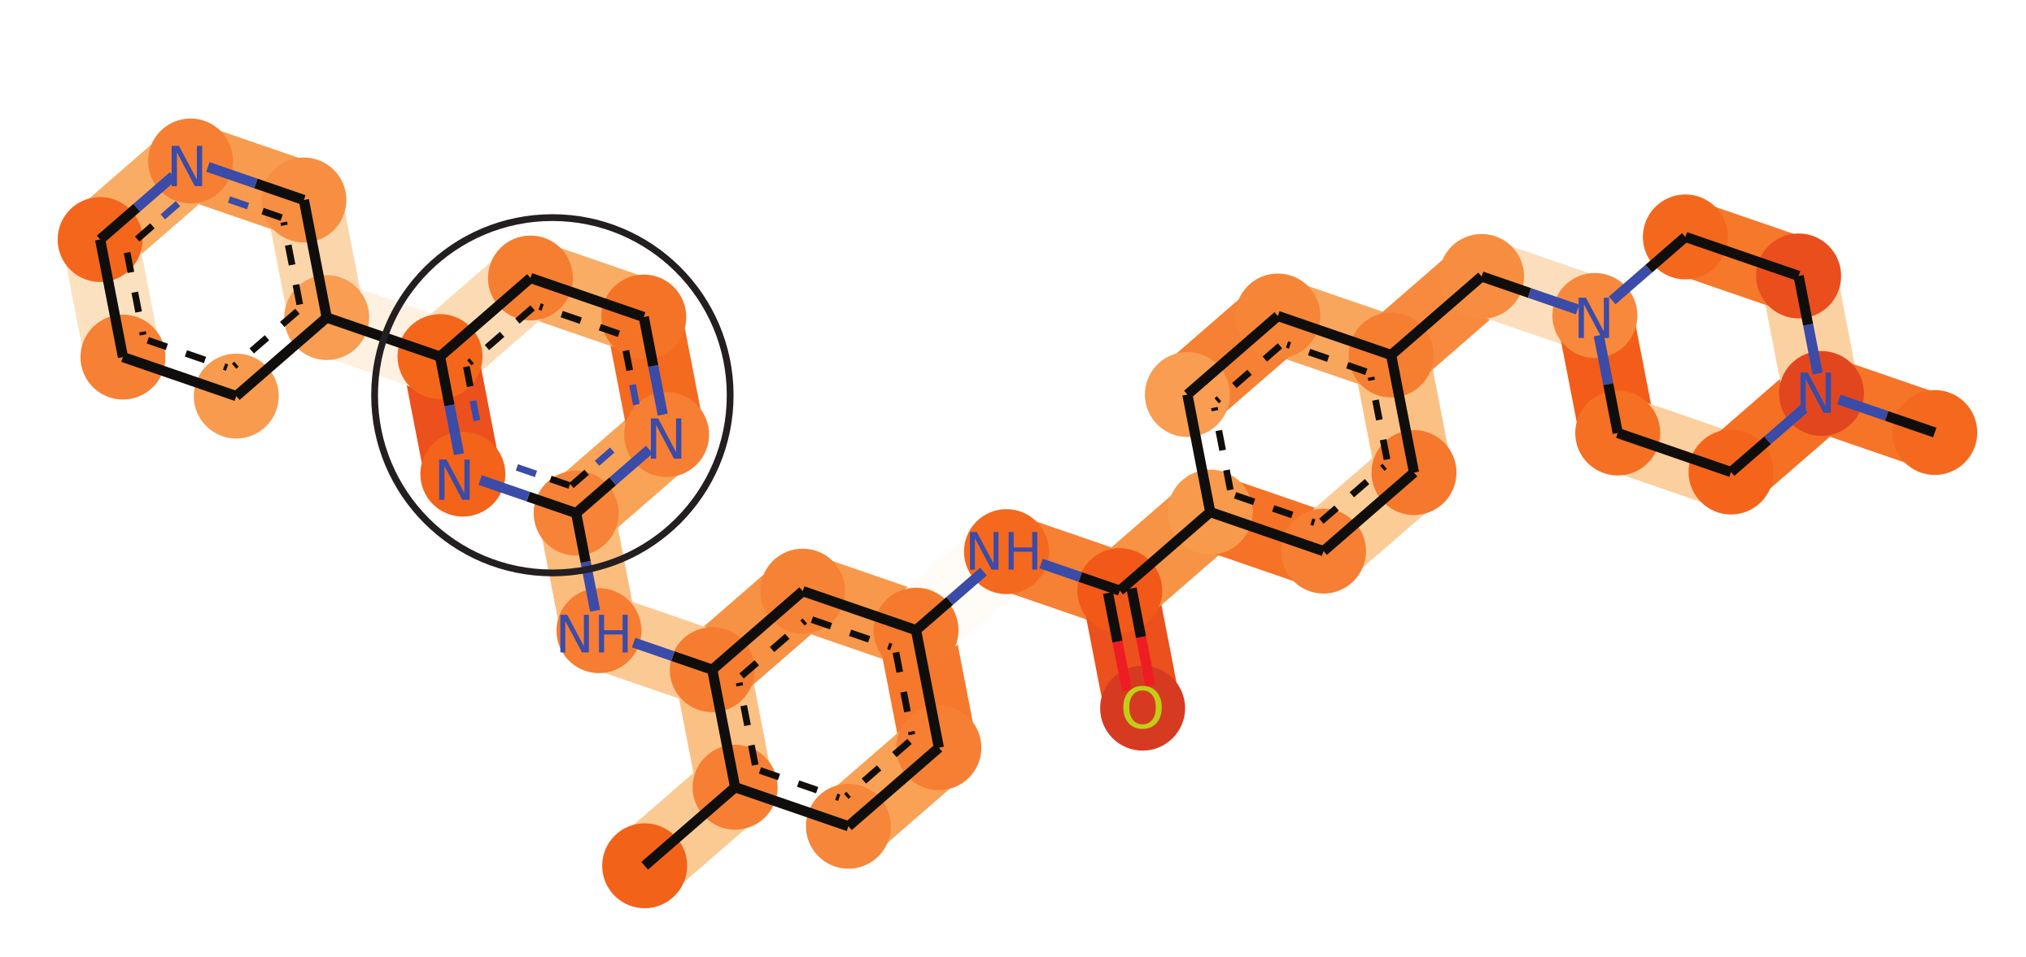
Attention-based methods
Manica, Matteo, et al. "Towards Explainable Anticancer Compound Sensitivity Prediction via Multimodal Attention-based Convolutional Encoders." Molecular Pharmaceutics. 2019.
Notes:
We used the same mechanism in a healthcare application developed at IBM for point-of-care prediction.. The task is to predict... . The attention mechanism was used to detect the main symptoms used to achieve a prediction.

Slide 29


Contrastive/counterfactuals methods
We do not always explain something in a direct way, e.g.
"Steve is the tall guy with long hair who does not wear glasses."
Local methods
Given a sample, how to "minimally" modify it so to change the prediction
Cf. Adversarial Robustness
Dhurandhar, Amit, et al. "Explanations based on the missing: Towards contrastive explanations with pertinent negatives." Advances in Neural Information Processing Systems. 2018.
Wachter, Sandra, Brent Mittelstadt, and Chris Russell. "Counterfactual Explanations without Opening the Black Box: Automated Decisions and the GPDR." Harv. JL & Tech. 31 (2017): 841.
Notes:
Yet another way to explain a machine learning model is to compute the importance of the features based on a game-theoretic concept called shapley values. The idea is that classification is a collaborative game where the features are the players. Shapley values are then the rewards that each of the players deserve.

Slide 30
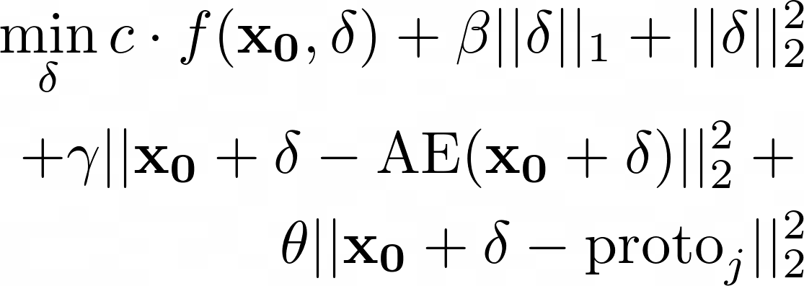
Contrastive/counterfactuals methods
Contrastive Explanations Method (CEM)
Dhurandhar, Amit, et al. "Explanations based on the missing: Towards contrastive explanations with pertinent negatives." Advances in Neural Information Processing Systems. 2018.
Wachter, Sandra, Brent Mittelstadt, and Chris Russell. "Counterfactual Explanations without Opening the Black Box: Automated Decisions and the GPDR." Harv. JL & Tech. 31 (2017): 841.
Van Looveren, Arnaud, et al. “Interpretable Counterfactual Explanations Guided by Prototypes.” arXiv:1907.02584. 2019.
Notes:
Yet another way to explain a machine learning model is to compute the importance of the features based on a game-theoretic concept called shapley values. The idea is that classification is a collaborative game where the features are the players. Shapley values are then the rewards that each of the players deserve.

Slide 31
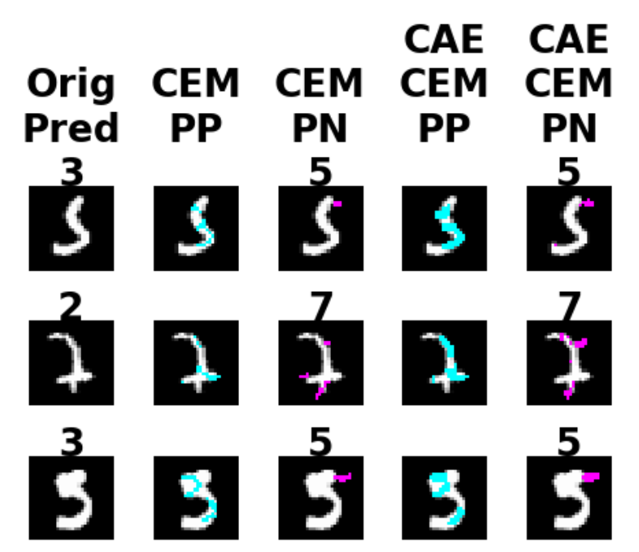
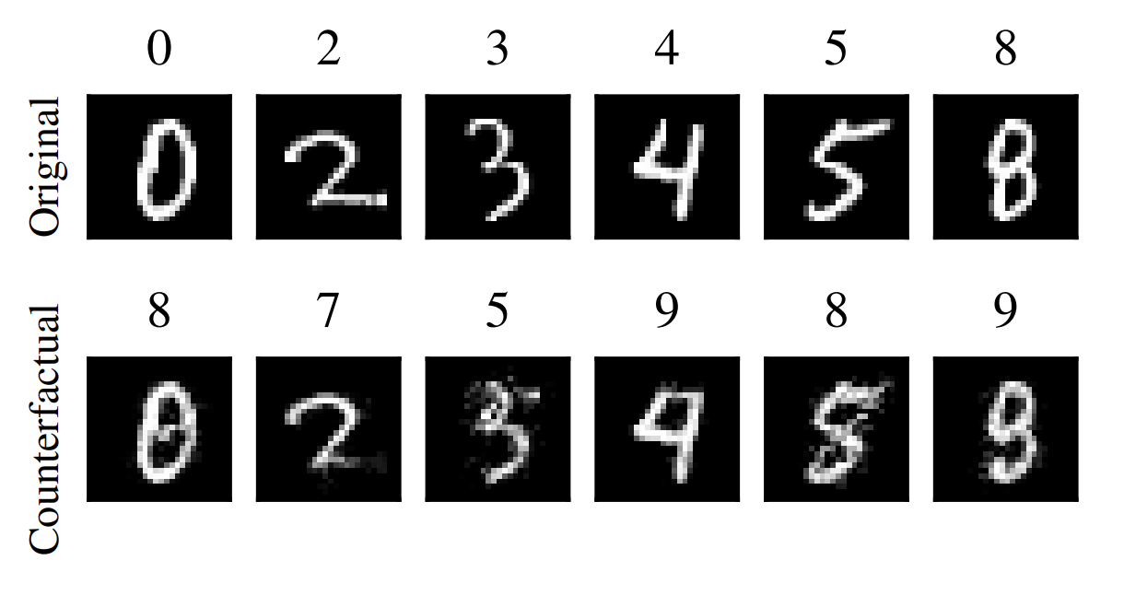
Contrastive/counterfactuals methods
Dhurandhar, Amit, et al. "Explanations based on the missing: Towards contrastive explanations with pertinent negatives." Advances in Neural Information Processing Systems. 2018.
Wachter, Sandra, Brent Mittelstadt, and Chris Russell. "Counterfactual Explanations without Opening the Black Box: Automated Decisions and the GPDR." Harv. JL & Tech. 31 (2017): 841.
Notes:
Yet another way to explain a machine learning model is to compute the importance of the features based on a game-theoretic concept called shapley values. The idea is that classification is a collaborative game where the features are the players. Shapley values are then the rewards that each of the players deserve.

Slide 32
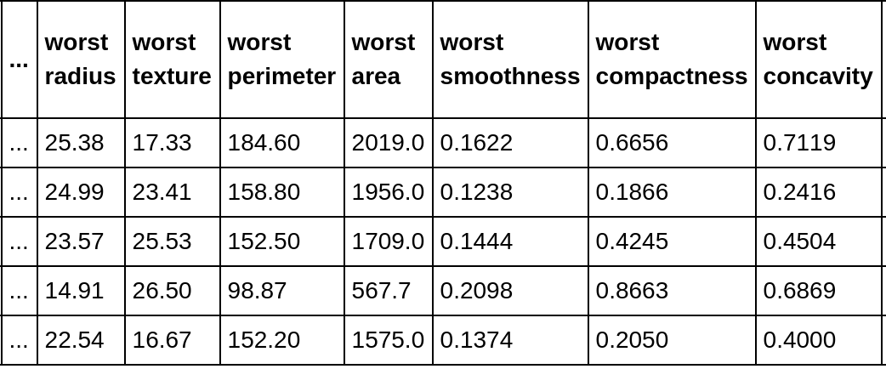
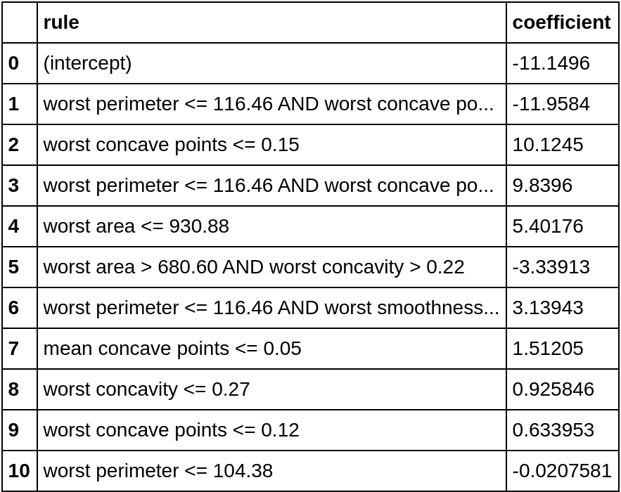
Rule-based models
Generalized Linear Rule Models (GLRM)
Rule lists are arguably easily interpretable
GLRMs generate rule-like features and then fit a linear model
Global methods
Works well on tabular data...
But what about text and images?
Wei, Dennis, et al. "Generalized Linear Rule Models." International Conference on Machine Learning. 2019.
Notes:
Yet another way to explain a machine learning model is to compute the importance of the features based on a game-theoretic concept called shapley values. The idea is that classification is a collaborative game where the features are the players. Shapley values are then the rewards that each of the players deserve.

Slide 33
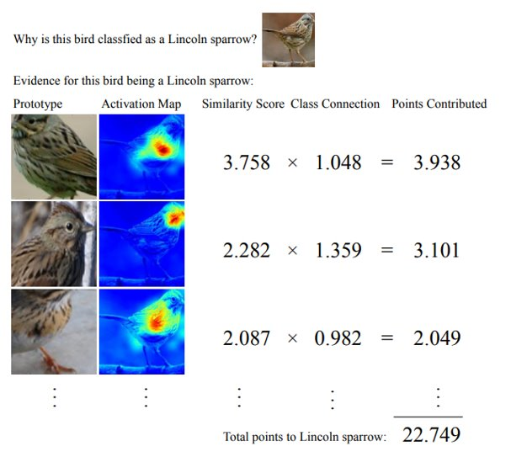
Other ways to (post-hoc) interpret a model
Example-based explanations
For each classified sample, find a similar example classified in the same way
Chen, Chaofan, et al. "This looks like that: deep learning for interpretable image recognition." arXiv preprint arXiv:1806.10574 (2018).
Notes:
Very quickly we can have a look at other ideas used in interpretability... the first one is based on another way how human sometimes gives explanations... I.e. by example.
Sometimes doctor do this to come up with a diagnosis... I also did this
Here is an example from a recent paper based on this idea. What they do is a little bit more fine-grained

Slide 34
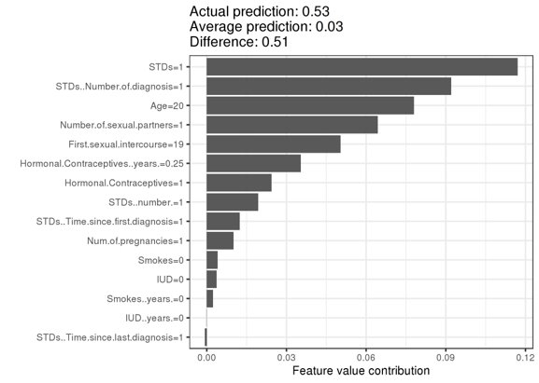
Other ways to (post-hoc) interpret a model
Shapley values
Concept from game theory
For a collaborative game, a shapley value represent the payout that a player in the game deserves
Features are the players, and the inference task is the game
Štrumbelj, E. & Kononenko, I. Knowl Inf Syst (2014) 41: 647. https://doi.org/10.1007/s10115-013-0679-x
Notes:
Yet another way to explain a machine learning model is to compute the importance of the features based on a game-theoretic concept called shapley values. The idea is that classification is a collaborative game where the features are the players. Shapley values are then the rewards that each of the players deserve.

Slide 35
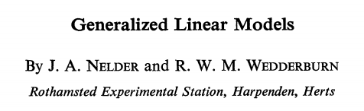
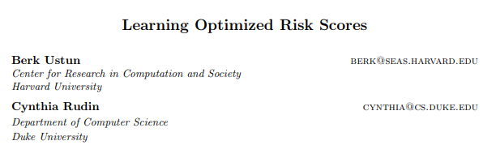
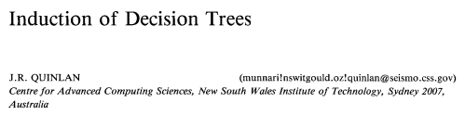
Surrogate methods
Any already interpretable methods can be used
Can be either global or local
An important concept for surrogate models is faithfulness: "how well is the surrogate model approximating the original model?"
Notes:
We conclude this list of methods by stressing the fact there exists, since ages, many models that are already interpretable such as linear models, decision trees and rule lists. These can then be used in a post-hoc fashion to try to explain other models, either locally or globally. LIME, in fact, is a surrogate linear model that is used locally. However, when it comes to surrogate models, a very important concept to take care of is the one faithfulness. That is a surrogate model should be able to approximate very well the original model. But, careful, what does well mean? Should it produce the same exact predictions as the original models or are some errors allowed. And if the surrogate is not 100% the same as the original model, how do we know that the explanations are valid for the original model?

Slide 36

Discussion
How do we evaluate interpretable methods?
Doshi-Velez and Kim suggests 3 tasks for evaluation:
Application-grounded (real tasks)
Let the end-users (field experts) evaluate it
Can be expensive and time consuming
Doshi-Velez, Finale, and Been Kim. "Towards a rigorous science of interpretable machine learning." arXiv preprint arXiv:1702.08608 (2017).
Notes:
To end the presentation, I'll give you an overview on some ongoing discussion about how to evaluate interpretability methods. Doshi-Velez and colleagues suggested that interpretability methods could be evaluated in 3 ways...
1. by domain experts

Slide 37

Discussion
How do we evaluate interpretable methods?
Doshi-Velez and Kim suggests 3 tasks for evaluation:
Human-grounded (simplified tasks)
Non-expert evaluators
e.g. decide which explanations seem more understandable, or try to simulate the model
Doshi-Velez, Finale, and Been Kim. "Towards a rigorous science of interpretable machine learning." arXiv preprint arXiv:1702.08608 (2017).
Notes:
2. by laymen on simplified tasks (simulation)

Slide 38

Discussion
How do we evaluate interpretable methods?
Doshi-Velez and Kim suggests 3 tasks for evaluation:
Functionally-grounded (proxy)
metrics that could be related to interpretability
formally defined and experimentally shown to be correlated to humans assessment
e.g. decision tree depth, BLEU score
Doshi-Velez, Finale, and Been Kim. "Towards a rigorous science of interpretable machine learning." arXiv preprint arXiv:1702.08608 (2017).
Notes:
Or programatically defined measures that could correlate well with what humans consider interpretable
The same idea was already used in machine translation

Slide 39

Discussion
What else should we consider about interpretable methods?
Expressive power, or "how understandable is it"
Translucency, or "knowledge about the model needed"
Portability, or usability
Algorithmic complexity, or runtime
Molnar, Christoph. "Interpretable machine learning. A Guide for Making Black Box Models Explainable", 2019. https://christophm.github.io/interpretable-ml-book/.
Robnik-Šikonja M., Bohanec M. (2018) Perturbation-Based Explanations of Prediction Models. In: Zhou J., Chen F. (eds) Human and Machine Learning. Human–Computer Interaction Series. Springer, Cham
Notes:
Finally, if we were to reach a consensus on the evaluation protocols, what should we evaluate in the explanations in trying to decide what to use.

Slide 40
Discussion
What else should we consider about interpretable methods?
Faithfulness, fidelity
Consistency (implementation invariance)
Representativeness
Stability
Novelty
Molnar, Christoph. "Interpretable machine learning. A Guide for Making Black Box Models Explainable", 2019. https://christophm.github.io/interpretable-ml-book/.
Robnik-Šikonja M., Bohanec M. (2018) Perturbation-Based Explanations of Prediction Models. In: Zhou J., Chen F. (eds) Human and Machine Learning. Human–Computer Interaction Series. Springer, Cham

Slide 41
IBM sign-off
IBM Research

